Slide 1
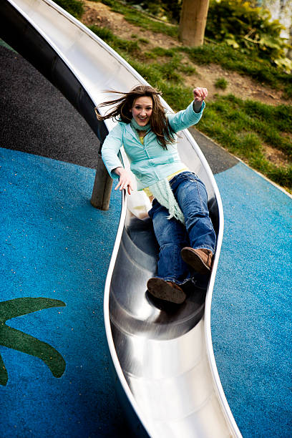
Do Now
Unjumble the words using the definition provided
OREFC a push, pull, or twist
GINSPR ENLAACB tool used to measure force
TWNEON the unit force is measured in
YCEHMTRIS what we studied last term
ESTEHPOYSH prediction of what is going on
NTOEARIVBOS we make these with senses

Slide 2
Observation
Using our senses
Inference
What we think is happening
Independent Variable
What is purposefully changed
Dependent Variable
What is measured
Controlled Variable
What is kept the same

Slide 3
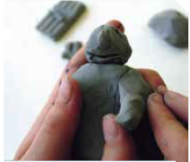

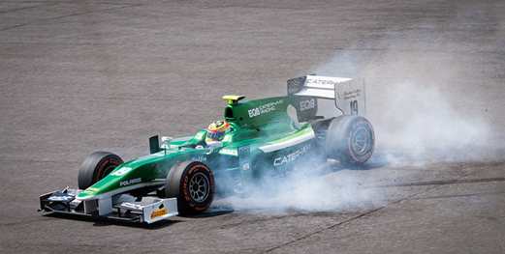
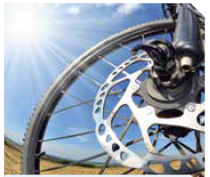
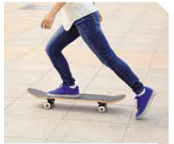
For each picture, describe what the force is doing.

Slide 4
Two students were interested in learning if coffee stays hotter for longer if you use a plastic cup or paper cup. For this experiment:
Independent variable
The cup’s material
Dependent variable
The coffee temperature
Controlled variables
The coffee itself, the coffee’s environment, whether milk was added
Write a hypothesis
The coffee in the plastic cup will stay hotter for longer

Slide 5
Balanced and Unbalanced Forces
Success Criteria
Draw vectors to describe the direction and magnitude of a force
Describe what makes a force “balanced” or “unbalanced”
Calculate the net force on an object

Slide 6
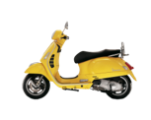
Draw vectors to describe the direction and magnitude of a force
All forces have two components:
A direction (what way the force is acting)
A magnitude (how strong the force is)
We often use arrows to show this. The arrow points in the direction of the force, and the bigger the arrow, the bigger the strength of that force. The scooter has a force moving it forwards that is bigger than the force moving it backwards.

Slide 7
Draw vectors to describe the direction and magnitude of a force
You can use these “force arrows” to determine what will happen to an object. The scooter below is moving forwards.
The scooter below is moving backwards

Slide 8
Draw vectors to describe the direction and magnitude of a force
Draw an arrow that describes the following situations:
A scooter moving to the left
A scooter moving to the right
A ball being thrown straight up
A ball being bounced
A basketballer trying to score a point​
​
​
​

Slide 9
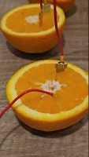
Brain Break
In this video, two of the facts shown are true, and the other is false. See if you can identify which is which before the end!
Notes:
https://www.youtube.com/shorts/-e9X9ESXpGo if video doesn’t work

Slide 10
Draw vectors to describe the direction and magnitude of a force
Forces can also combine. Right now, the scooter is still moving forwards.
But, we can make it move faster by also pushing it forwards from the back:

Slide 11
Draw vectors to describe the direction and magnitude of a force
Just like forces can add together, they can also be subtracted. Again, looking at the scooter moving forwards:
If we add a force to pull it back, however, it will come to a stop.

Slide 12

Draw vectors to describe the direction and magnitude of a force
Forces aren’t always the same magnitude – consider jumping.
When you jump up, you push off the ground with some force. But, gravity is still pulling you down. Since you starting moving up, though, gravity must be weaker than your pushing force.
To draw this, we would do a bigger arrow up, and a smaller arrow down.

Slide 13

Draw vectors to describe the direction and magnitude of a force
Another example – a skydiver deploying their parachute.
Because they’ve slowed down, the force pushing the parachute up must be bigger than the gravity pulling them down.

Slide 14
Draw vectors to describe the direction and magnitude of a force
However, eventually they stop slowing down and go down at a single speed.
At this point, because their speed isn’t changing, they’re not changing shape, and they’re not changing direction, the forces must be equal.

Slide 15
Draw vectors to describe the direction and magnitude of a force
Draw two arrows that describes the following situations:
A skydiver who is falling down, with air pushing them up
A scooter that is moving forwards with friction slowing it down
A tennis player who just hit a ball that was coming towards them

Slide 16
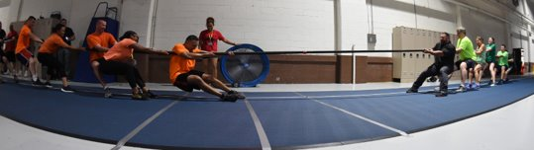
Describe what makes a force “balanced” or “unbalanced”
Tug-of-war is involves forces of push and pull. Teams pull on the rope and remain standing because they push against the ground.​
What do you think would happen if one team pulled harder than the other team (used more force)? ​
What do you think would happen if both teams pull the same amount (with the same amount of force)?​

Slide 17

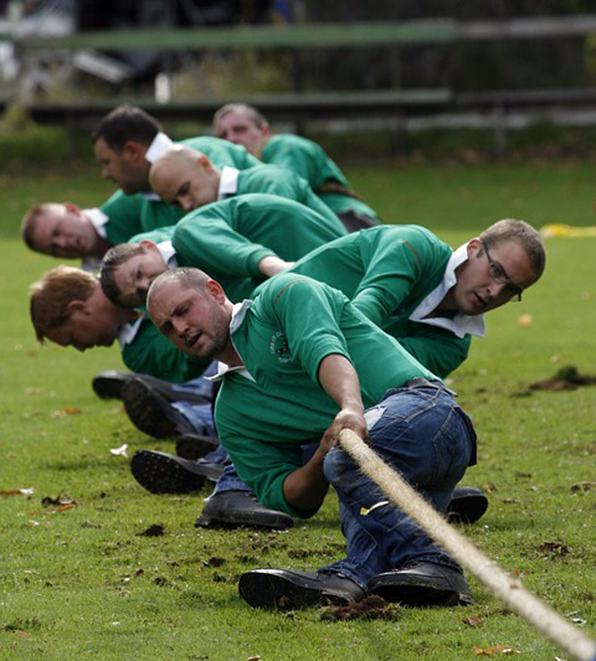
Describe what makes a force “balanced” or “unbalanced”
Forces can be balanced or unbalanced.​ So, in the tug of war example:​
If one team uses more force, the forces are unbalanced forces. One force is larger than the other. ​
If both teams use the same amount of force, the forces are balanced forces. This means the forces are the same size or equal.​

Slide 18
Describe what makes a force “balanced” or “unbalanced”
If the forces are unbalanced, there is a change in motion. This is just like the tug of war match when one side starts to win.

Slide 19
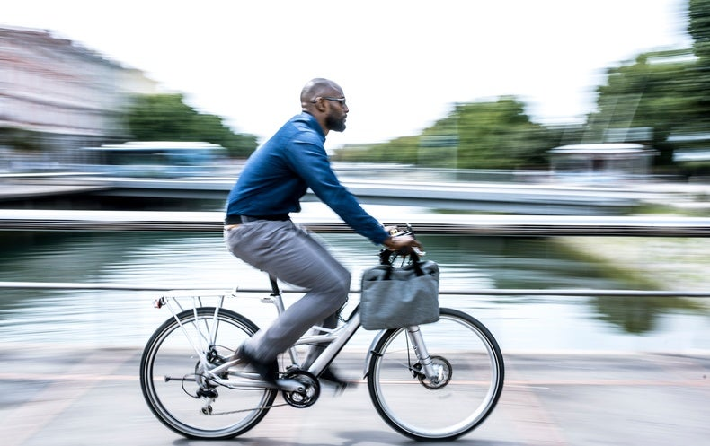
Describe what makes a force “balanced” or “unbalanced”
If the forces are balanced, there is no change in motion. This is just like the tug of war match where everyone is equal.
Objects can still move, they just won’t get faster, slower, or change direction. Just like riding a bike – you might be pedaling forwards, but not getting faster because of friction or if you’re going up a hill.

Slide 20
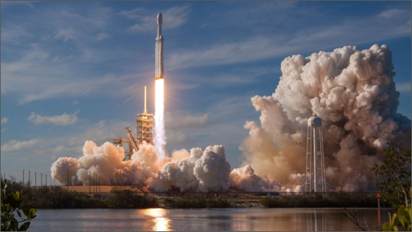
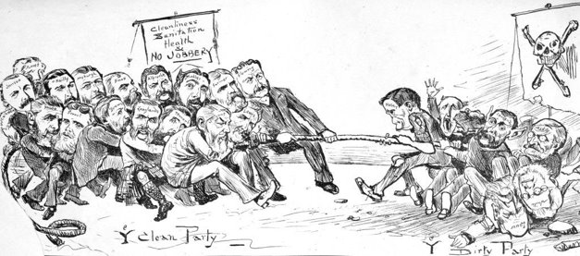
Describe what makes a force “balanced” or “unbalanced”
For each of the following examples, state if the forces are balanced or unbalanced.
​
​
​
​

Slide 21
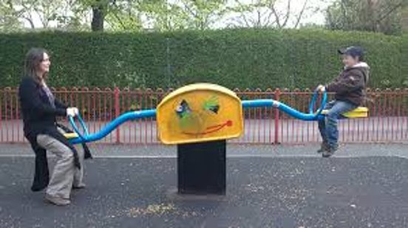
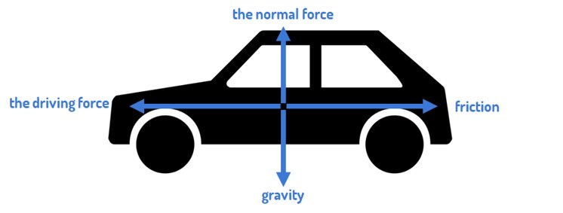
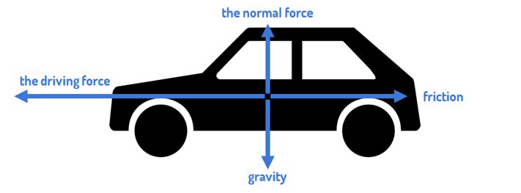
Describe what makes a force “balanced” or “unbalanced”
For each of the following examples, state if the forces are balanced or unbalanced.
​
​
​
​

Slide 22
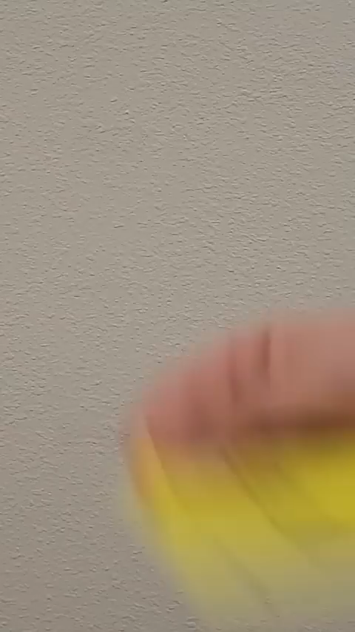
Brain Break
In this video, two of the facts shown are true, and the other is false. See if you can identify which is which before the end!
Notes:
https://www.youtube.com/shorts/V0o6wFMuvIo if video doesn’t work

Slide 23
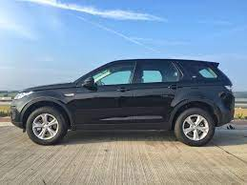
Calculate the net force on an object
If we know the amount of force on an object, we can calculate the net force. The net force is the force felt by the object. E.g., even though gravity is pulling you down, you’re not moving because a force is pushing you up. So your net force is 0 N.
15,000 N
15,000 N
Notes:
https://www.youtube.com/watch?v=NqdOyxJZj0U if video doesn’t work

Slide 24
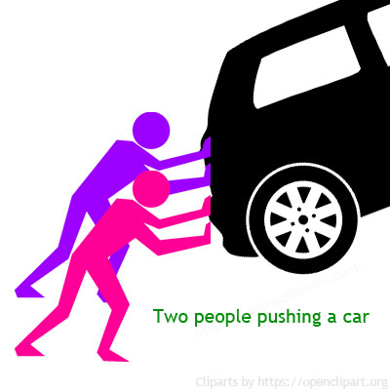
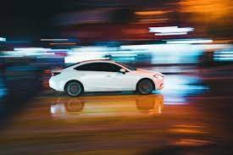
Calculate the net force on an object
We can calculate the net force by adding the forces if they are in the same direction, or subtracting them if they’re in opposite directions.
Importantly, when we calculate the net force, we always give the magnitude AND direction.
80 N
50 N
10 N
100 N
30 N
90 N
Notes:
https://www.youtube.com/watch?v=NqdOyxJZj0U if video doesn’t work

Slide 25
Calculate the net force on an object
Calculate the net force in each situation.
50 N
50 N
200 N
150 N
150 N
50 N

Slide 26
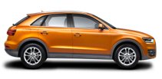
Calculate the net force on an object
Are the forces balanced or unbalanced? What is the net force on each car?
500 N
50 N
300 N
300 N
300 N
1000 N

Slide 27
Balanced and Unbalanced Forces
All forces have two components:
A direction (what way the force is acting)
A magnitude (how strong the force is)
Forces can be balanced or unbalanced if these two things are equal or unequal.
If the forces are unbalanced, there is a change in motion.
If the forces are balanced, there is no change in motion.

Slide 28


Balanced and Unbalanced Forces
If you want to move a stationary object you need to create an unbalanced force.​
If an object is stationary it means that all forces are balanced.​
To move the object, like with lifting weights, you need to push, pull or twist something, and unbalance the forces to make the object move.​
​
​

Slide 29
Balanced and Unbalanced Forces
Success Criteria
Draw vectors to describe the direction and magnitude of a force
Describe what makes a force “balanced” or “unbalanced”
Calculate the net force on an object

